Slide 1
Revit Logger
Usage;
Log Key data from Revit to Enable change management add-ins and dynamic Revit Export

Slide 2
Revit Logger
Log Naming
FileName_FileGUID_ExternalGUID_UTCTime_Log.jsonl

Slide 3
Components
Revit Addin
Revit External Application to Apply Settings, Activate and Export Log Data
C# CLI/ Service tool to compare Logs to generate “Change” logs triggered after export of log data
Log Format
Json Lines Format
Full Log / Change Data

Slide 4
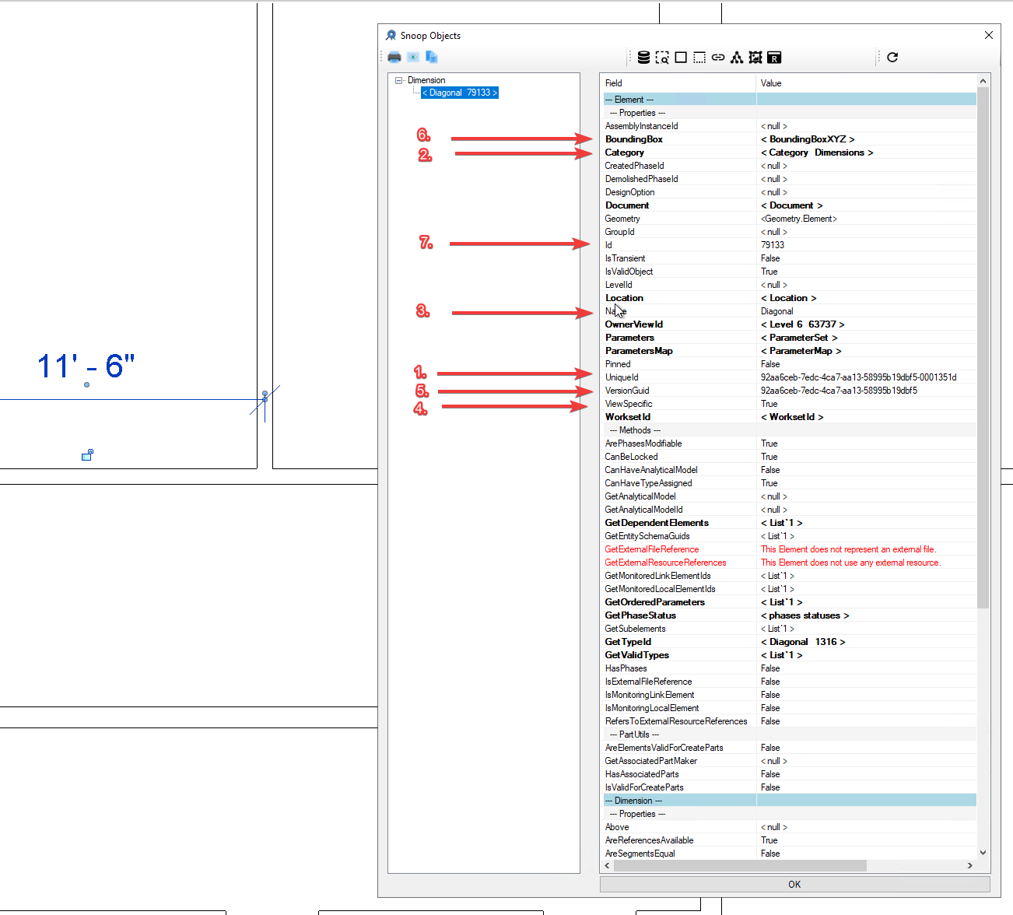
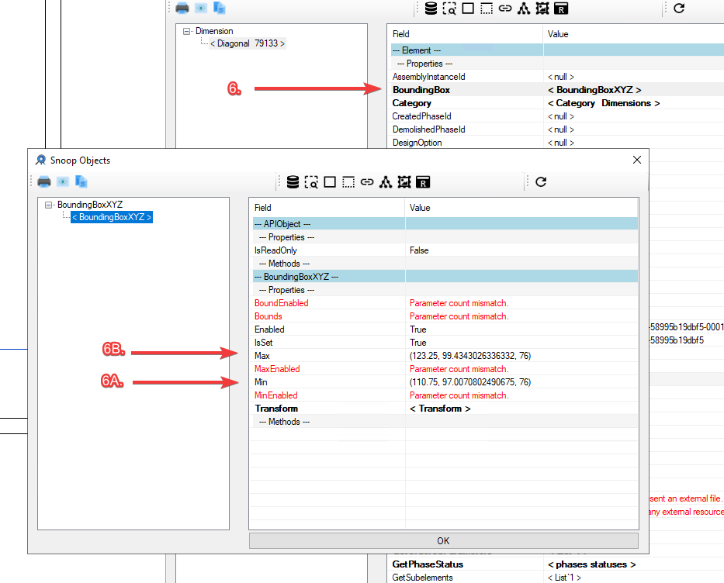
{“ObjectIds”: [“<UniqueId - #1>”, “<Id -#7>”, “<VersionGuid -#5>”], “ObjectProperties”:[“<Name #3>”, “<Category>”, “<ViewSpecific #5>”], “BBox”: [[“<BoundingBoxMin - #6A>”],[“<BoundingBoxMax #6B>”]], “Notes”: [“<UserNote>”, “>ProjectNote>], “ObjectStatus”:”<New,Modified,Deleted>”}

Slide 5
Log Components
ObjectIds – Machine-readable IDs to identify and track changes
{“ObjectIds”: [“<UniqueId>”, “<Id>”, “<VersionGuid>”],
“ObjectProperties”:[“<Name>”, “<Category>”, “<ViewSpecific>”],
“BBox”: [[“<BoundingBoxMin>”],[“<BoundingBoxMax.”]],
“Notes”: [“<UserNote”, “<ProjectNote>],
“ObjectStatus”:”<New,Modified,Deleted,Unchange>”}}
ObjectProperties – User and Machine-readable categories for finding and filtering
BBox – Bounding Box for basic geometric change comparison
Notes – Location for User/ Project Provided Logging of data to be used for change classification
ObjectStatus – Values Calculated from Previous Log that capture status of the object at this point in time.

Slide 6
Log Naming
<FileName>_<RevitModelGUID>_<ExternalID><UTCTime>_Log/Change.jsonl
Log = Full Export
Change = Only Changes from Previous Log

Slide 7
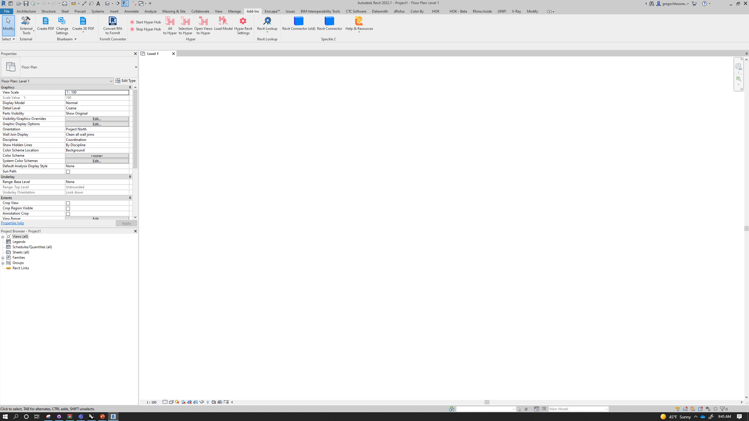






On/Off
Notes
Settings
Select From Log(s)
On/Off
Notes
Settings
Select From Log(s)
Revit Logger
Revit Logger
Revit Logger - Settings
Revit Logger - Notes
Details
Demo
Notes
Demo
Demo
Log Path
User Note
<pick a location to save logs> (required)
<enter a user note (optional)>
Project Name
Project Note
<enter a project name> (required)
<enter a project note (optional)>
Project Number
<enter a project number> (required)
External Project ID
Cancel
Save
<enter a project number> (optional)
Scope
Revit Logger - Progress
All
Model Categories
Annotation Categories
Log Progress
Columns;Ducts;Grids
Import Settings
Cancel
Save

